Slide 1

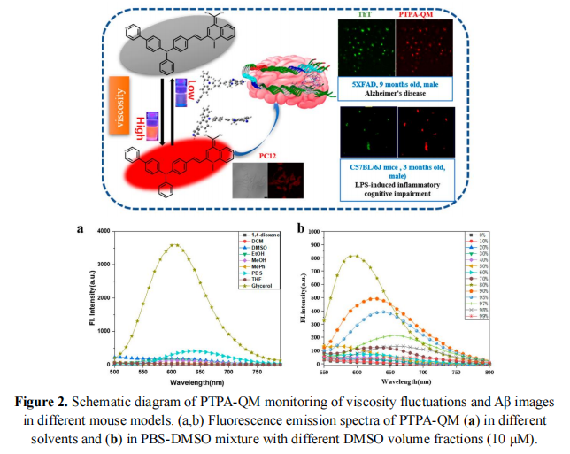
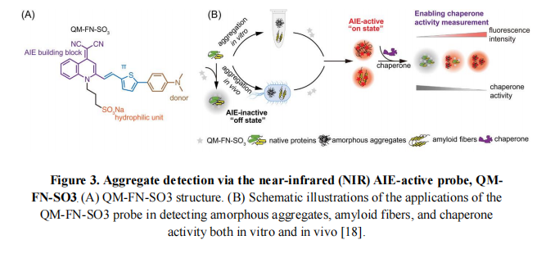
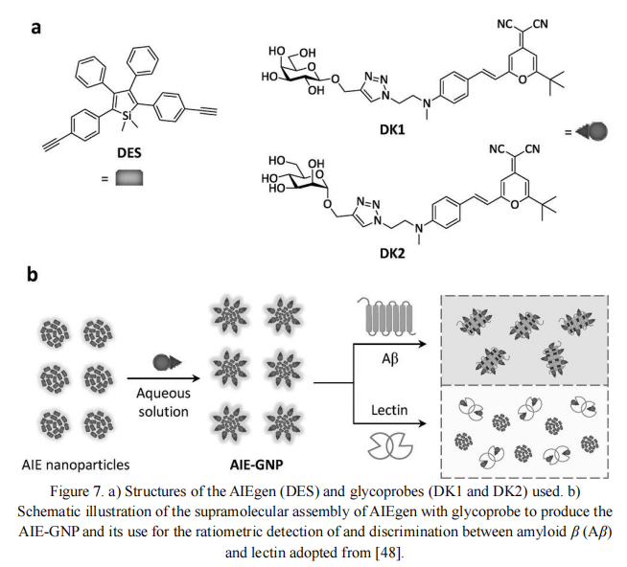
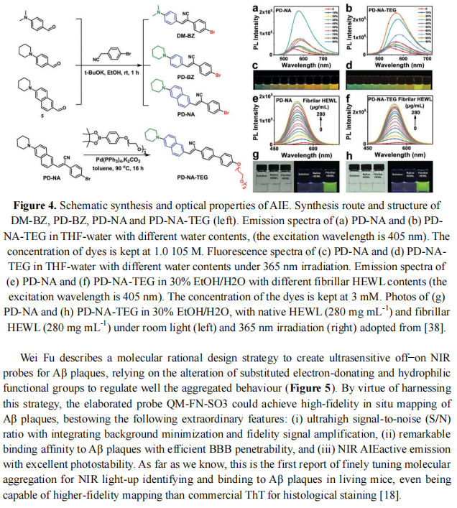
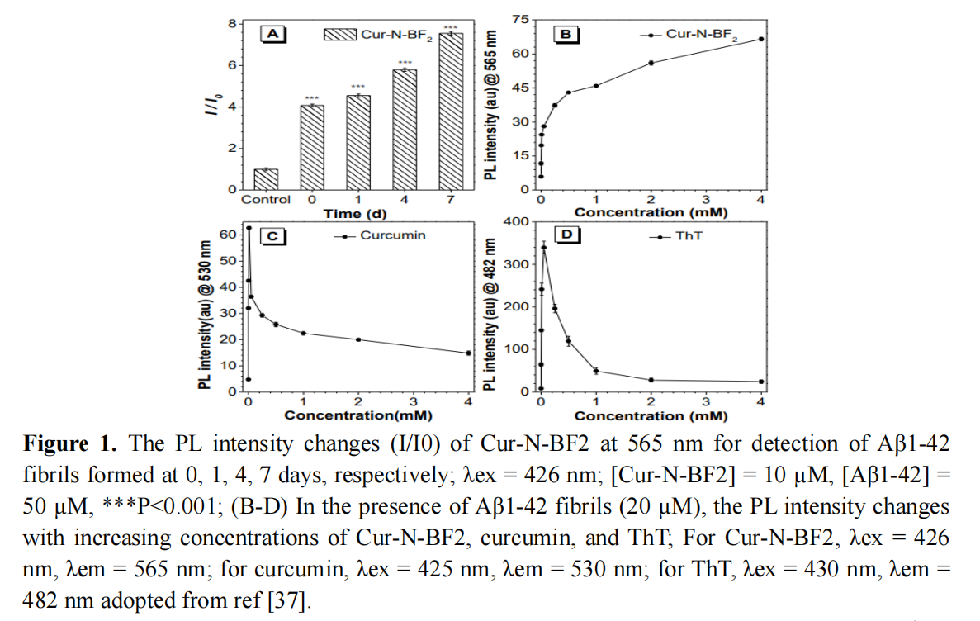

Detection of Aβ Aggregation by Aggregation-Induced Emission (AIE) Probes in Alzheimer’s Disease
Haider Alam, Rakhmatullokh Kakhramonov(Presenting Author)
School of International Education, China Pharmaceutical University, Nanjing, China
Background
Alzheimer’s disease (AD) involves the accumulation of amyloid-β (Aβ) aggregates, including oligomers, protofibrils, and fibrils. Soluble oligomers are considered the most neurotoxic yet remain difficult to detect due to their transient and heterogeneous nature. Traditional dyes such as Thioflavin T and Congo Red suffer from aggregation-caused quenching (ACQ), low selectivity, photobleaching, and background interference, limiting their usefulness in early diagnosis and in vivo imaging. Aggregation-Induced Emission (AIE) probes address these limitations through a “dark-to-bright” activation: they are non-emissive in solution but strongly fluorescent when bound to Aβ aggregates. This mechanism provides high sensitivity and minimal background noise.
Key Findings from Representative AIE Probes
Methods
We analyzed representative AIE-based probes by examining their molecular structures, fluorescence activation mechanisms, and spectral responses (Figures 1–4, 7). Key parameters evaluated included:
Turn-on fluorescence upon Aβ binding
Selectivity toward different Aβ species
Emission wavelength shifts
Molecular design features influencing AIE behavior
Comparative data from recent studies were used to evaluate probe performance and biological applicability.
Conclusion
AIE-based probes provide highly sensitive, selective, and stable “light-up” detection of Aβ aggregates. Their tunable structures and strong fluorescence responses make them promising tools for early Alzheimer’s diagnosis and for developing future Aβ-targeted imaging and theranostic strategies.
Objectives:
The objectives of this work are outlined as follows:
To evaluate the performance of AIE-based fluorescent probes in detecting Aβ aggregates.
To analyze representative AIE molecules and their mechanisms of fluorescence activation.
To compare their advantages over traditional amyloid detection tools.
To highlight the potential of AIE probes for early diagnosis and theranostic applications in AD.
Poster
Digital
Version

